Slide 1
Developing Cross Platform Application using PyQt5
Xiaojun Pan
2017/12/21

Slide 2
Reference：
http://pythonthusiast.pythonblogs.com/230_pythonthusiast/categories/426_qt_pyqt_and_pyside_tutorial.html
the book Rapid GUI Programming with Python and Qt

Slide 3
Agenda
Introduction

Slide 4
Introduction

Slide 5
Python Application
Preparation

Slide 6
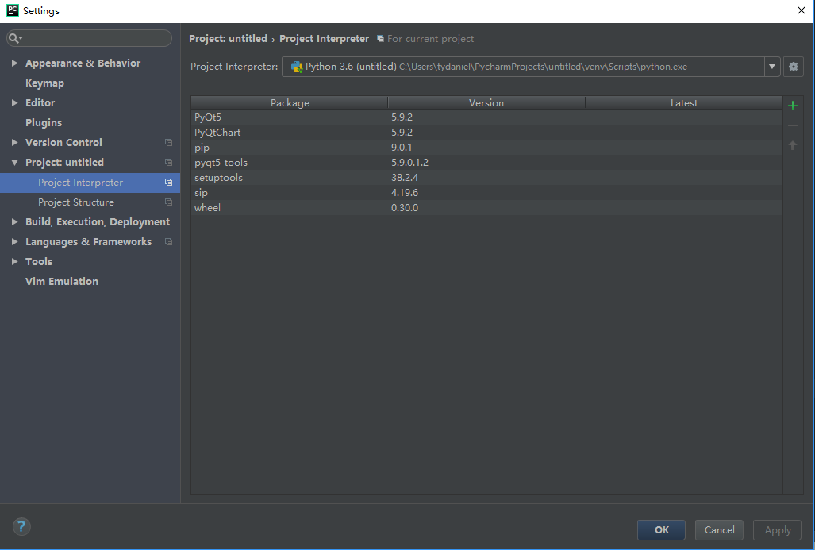
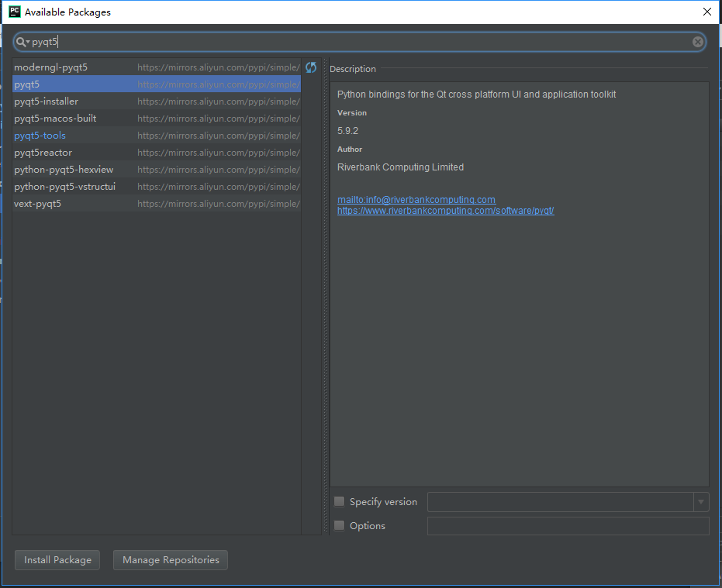
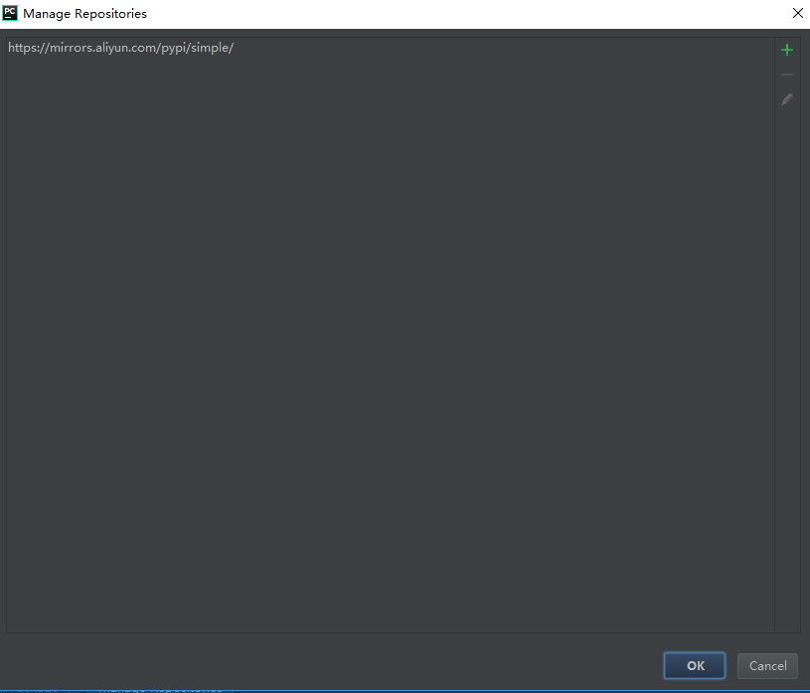
Preparation Install Project Interpreter
Interpreters:
●PyQt5
●Pyqt5-tools
(Qt Designer)
●PyInstaller
Repositories:
https://mirrors.aliyun.com/pypi/simple/

Slide 7
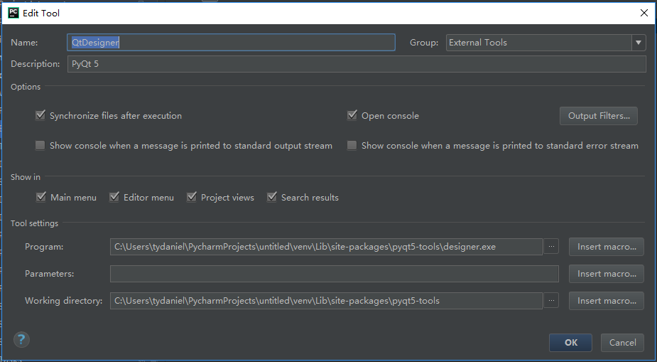
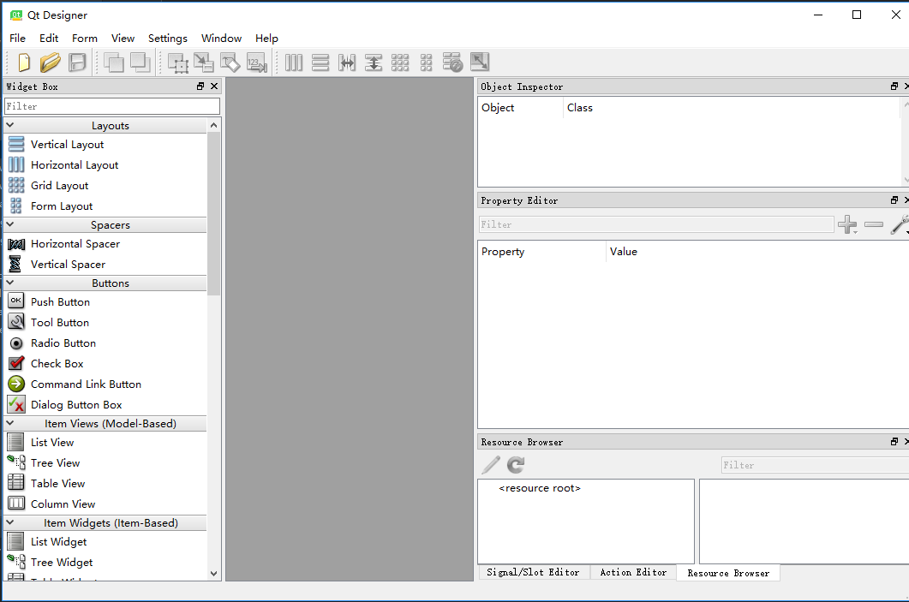
External Tools -- QtDesigner

Slide 8
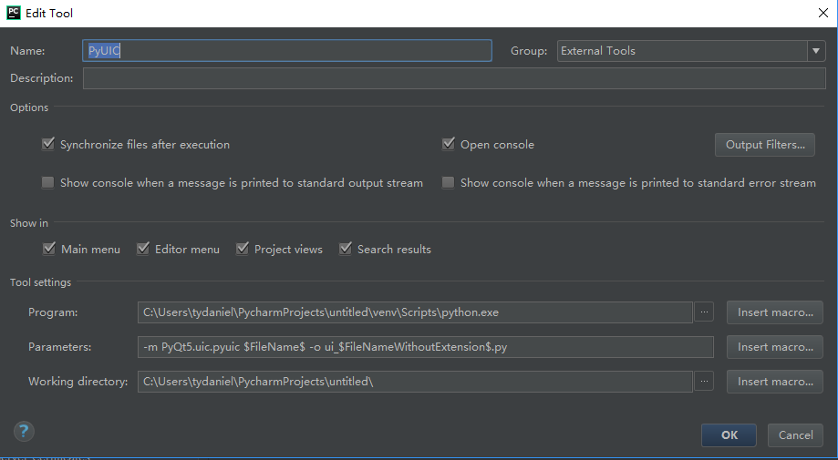
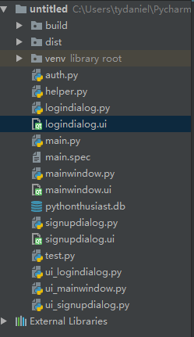
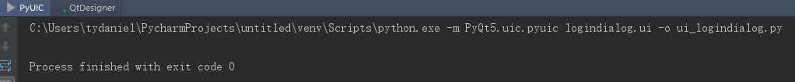
External Tools -- PyUIC
To convert a Qt file(*.ui) to Python script

Slide 9
Python Application
TTD
Unittest by python

Slide 10
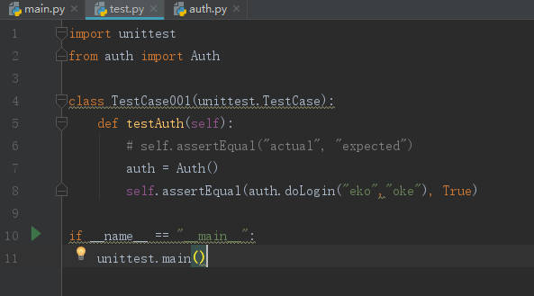
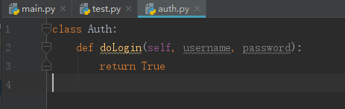
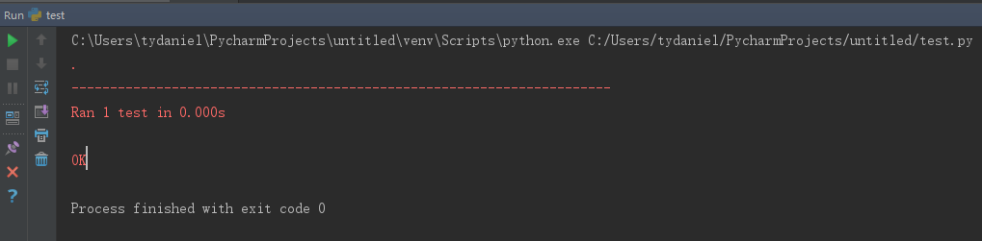
PyUnit

Slide 11
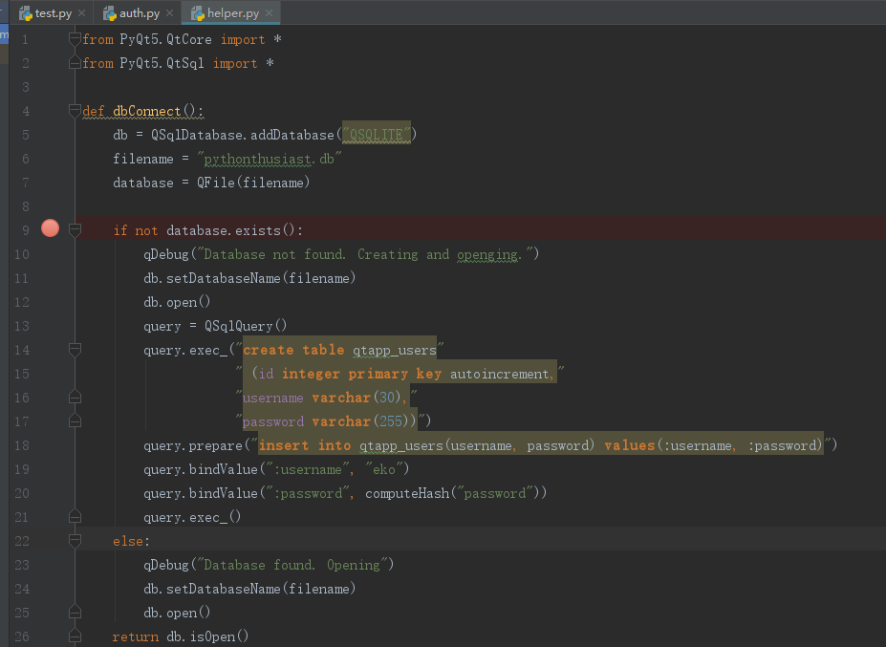
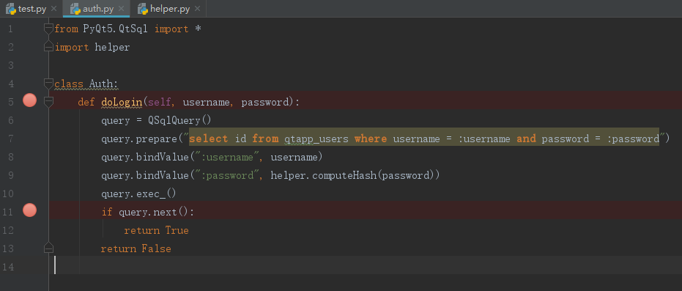
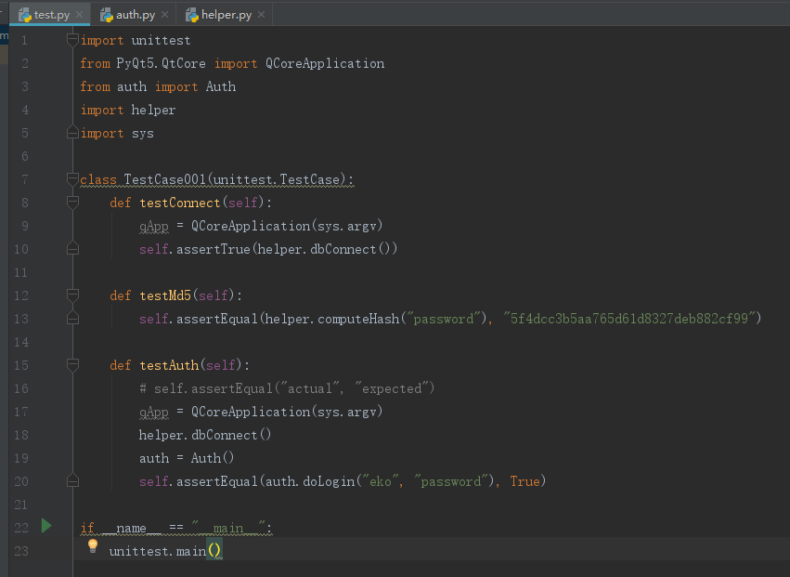
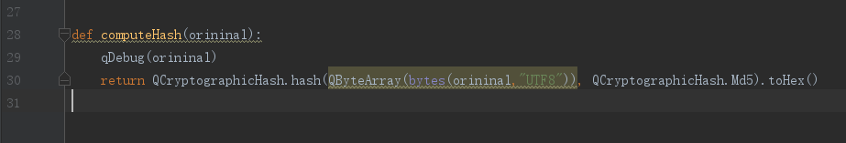

Slide 12
Python Application
Make a Installer for Python project by Pycham

Slide 13
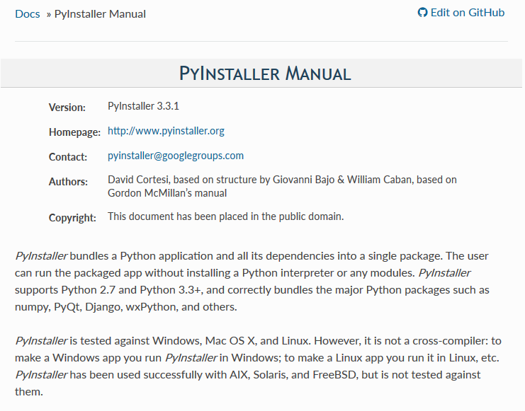
PyInstaller 3.3 -- Introduction
Manual:
https://pyinstaller.readthedocs.io/en/stable/index.html#

Slide 14
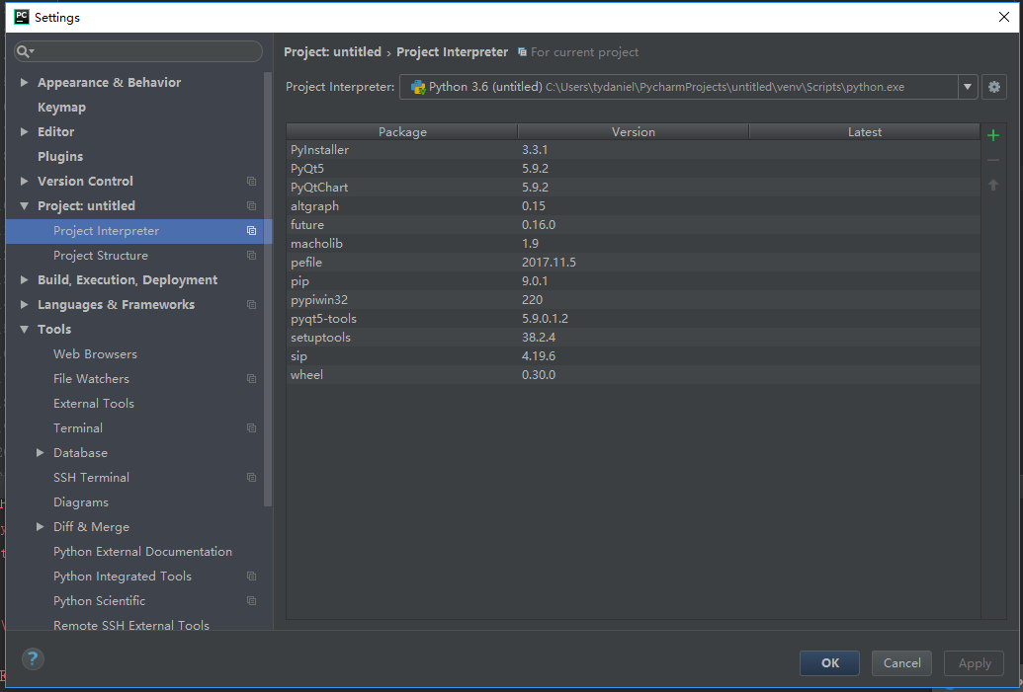
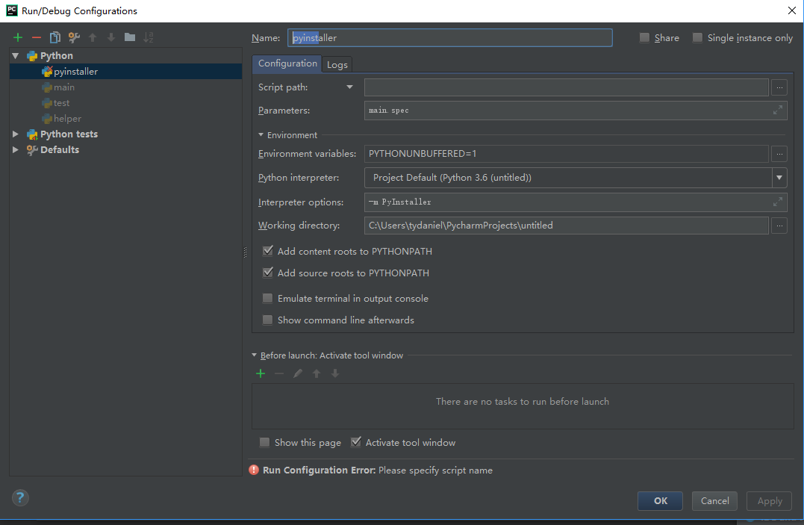
PyInstaller 3.3 -- Preparation (Project Interpreter and Startup Tasks)
Configure on PyCharm:
https://stackoverflow.com/questions/33906539/configuring-pycharm-to-run-pyinstaller
Doc Reference:
https://pyinstaller.readthedocs.io/en/stable/

Slide 15
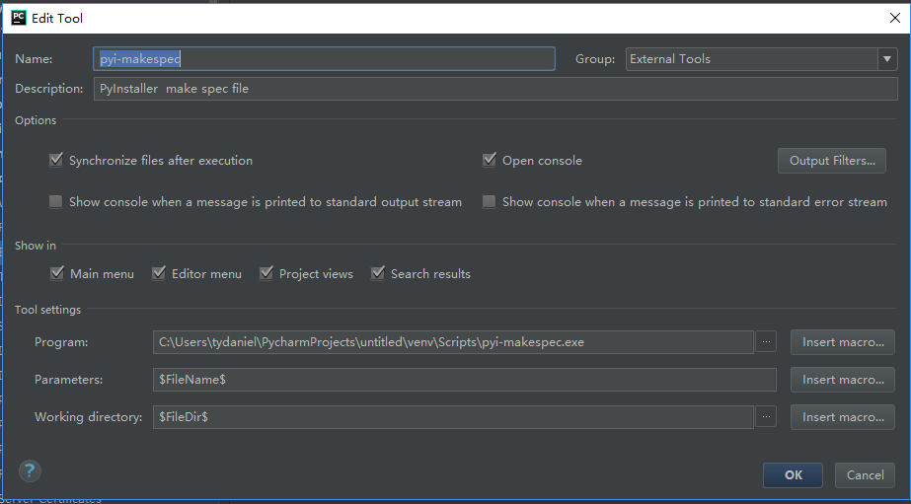
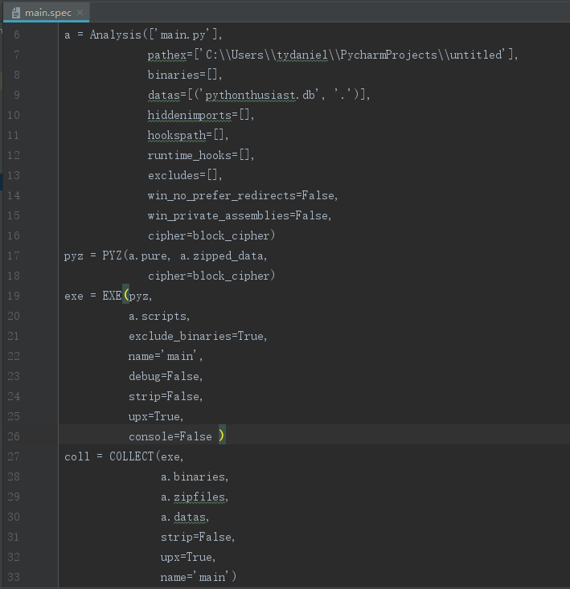
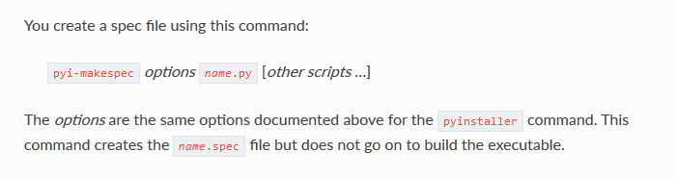
PyInstaller 3.3 – Make spec file pyi-makespec(to generate a spec file)
CLI: pyi-makespec.exe main.py
Doc Ref:
https://pyinstaller.readthedocs.io/en/stable/spec-files.html

Slide 16
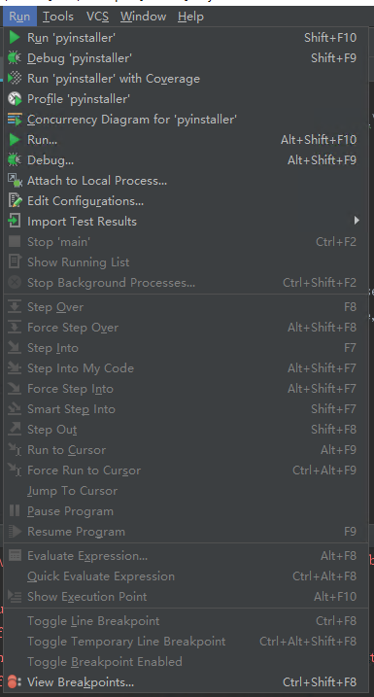
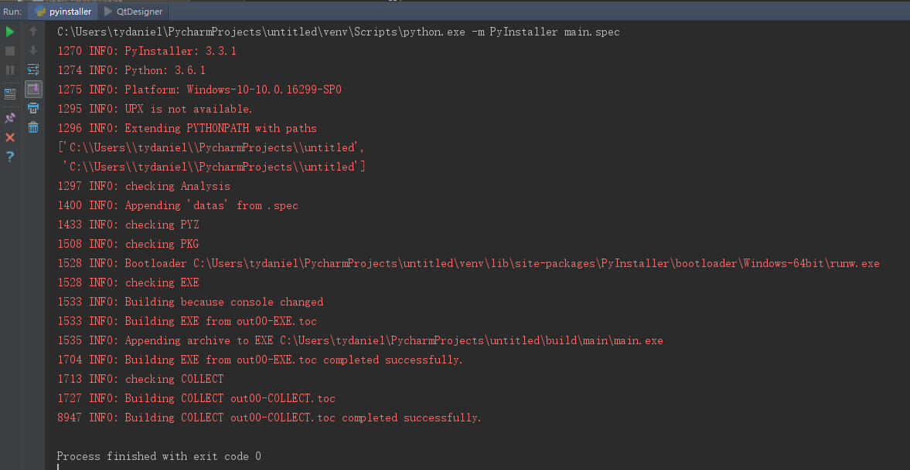
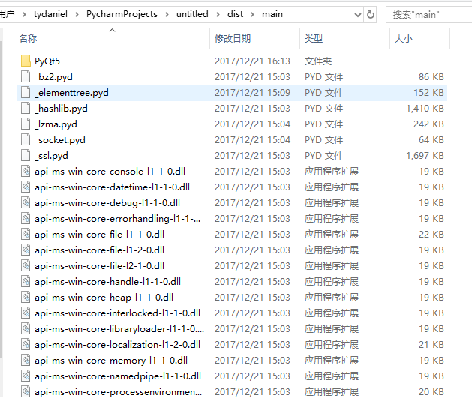
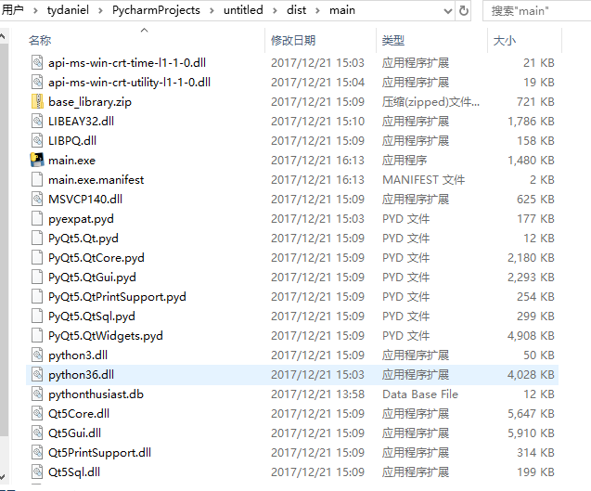
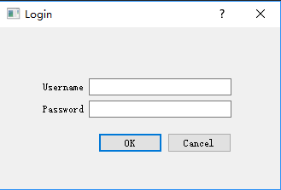
PyInstaller 3.3 -- To bundle apps and all dependences into a package(Exe file)

